Slide 1
C# project: LEGO® analogy Project MEGO
Oleksii Kosobutskyi and Adam Czub

Slide 2

Final?
Not really
https://sadanduseless.b-cdn.net/wp-content/uploads/2014/09/harold1.jpg

Slide 3
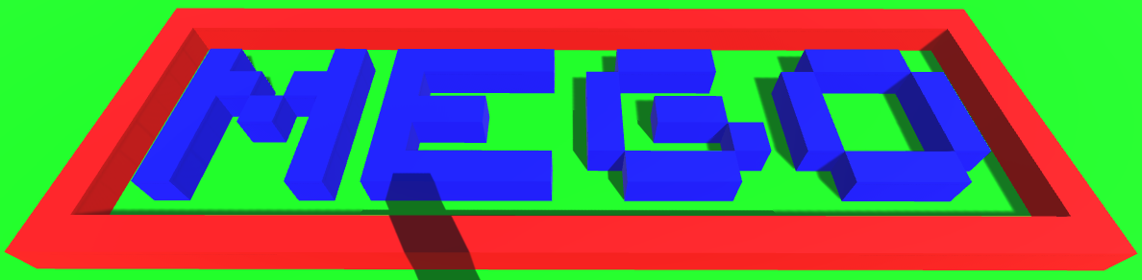
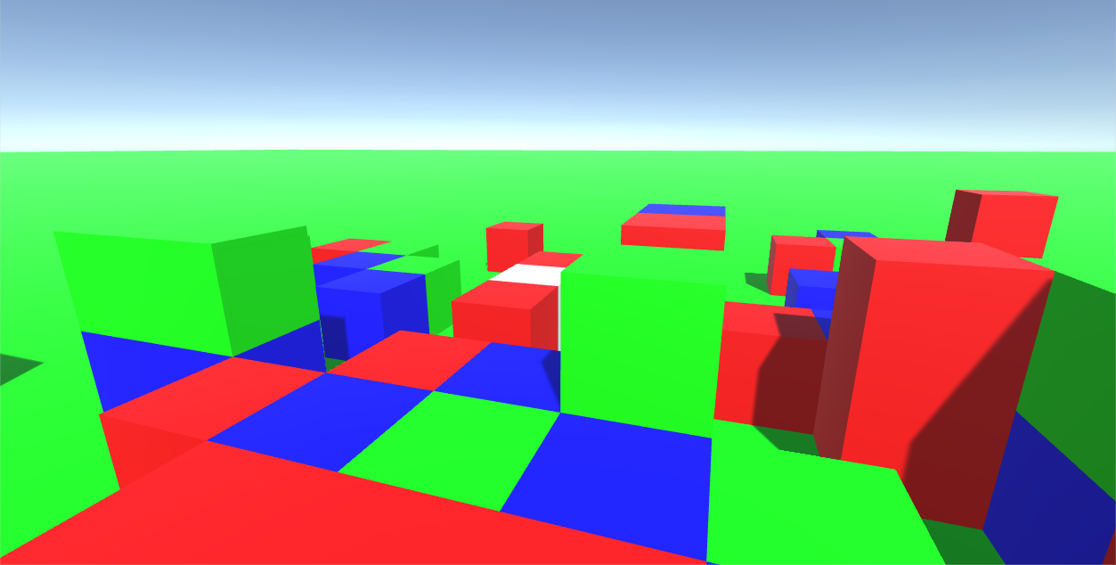
LEGO-like bricks building
Child friendly
Creative designing tool
Unity environment
Imagine, Design, Create.

Slide 4
Achievements
Alredy done:
FPS game
Limited moves (possible jumping)
Possibility of placing blocks
Blocks can have different colors

Slide 5
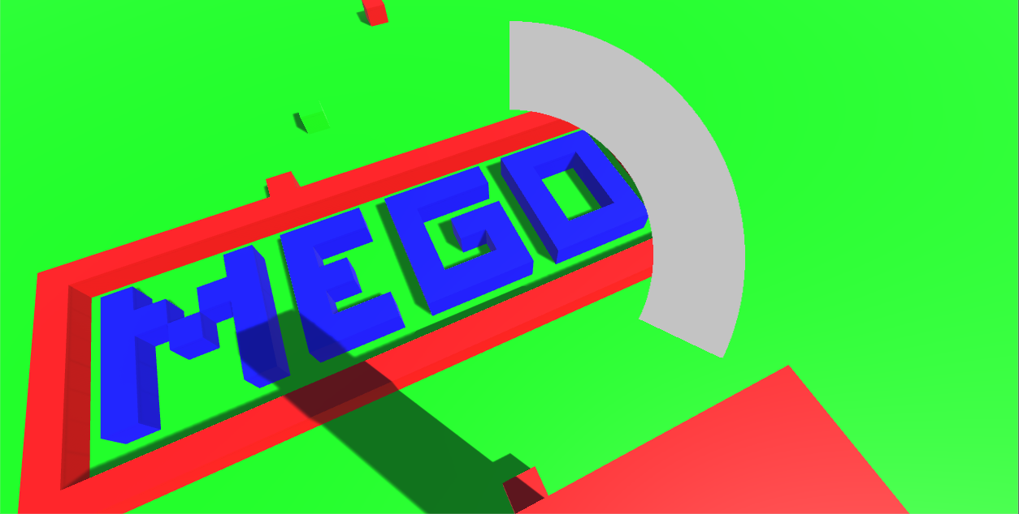

Slide 6
Possible imprvement
Add in-game color and brick shape circle live-menu
Change perspective
Deleting blocks
Better graphics
Multiplayer?

Slide 7
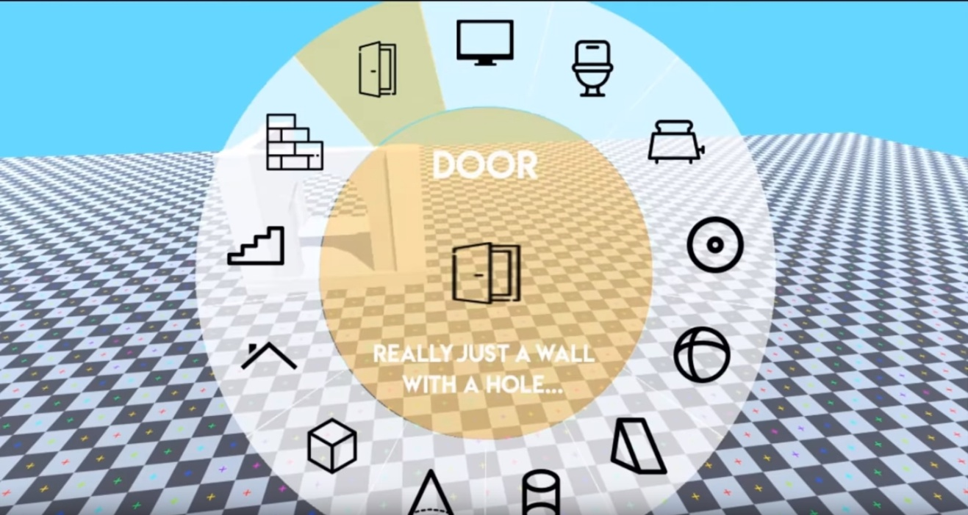
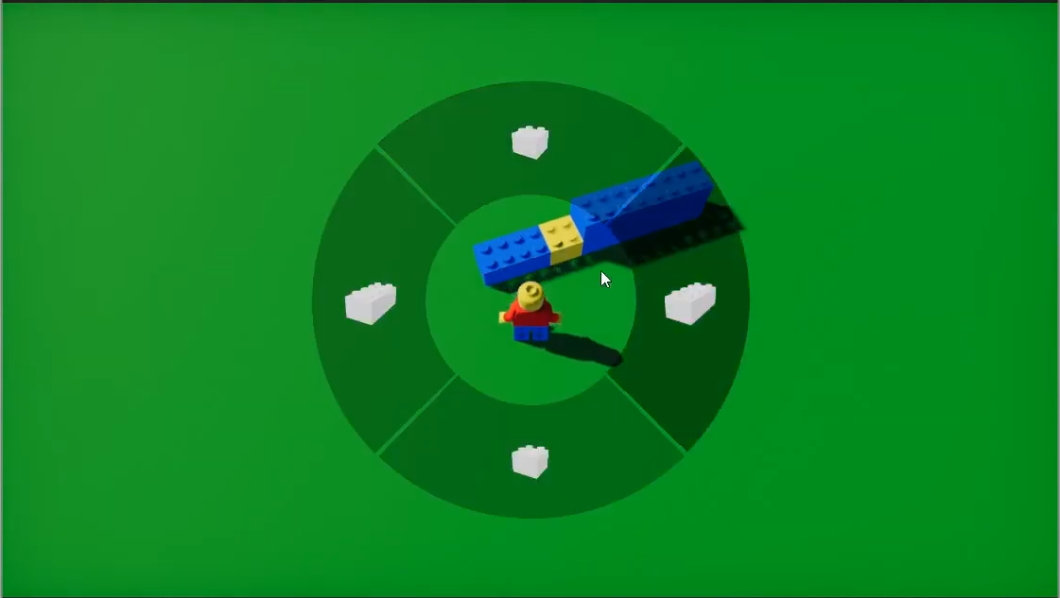
Sources
https://www.youtube.com/watch?v=tKmsMfoPTC0
https://www.youtube.com/watch?v=tPH_BYRsvxI

Slide 8
Thank you for your attention
Have a nice day ☺

